Slide 1
Mocking Birds, Literacy Rates, Cultural Competence and Racism Informed Education
Robert S. Wright, MSW, RSW
Lecturer, MSVU Child & Youth Studies
Social Worker in Private Practice
www.robertswright.ca

Slide 2
Who is Robert Wright?
Lecturer, MSVU, CHYS, Afrocentric Cohort in MEd LLL
Registered social work private practitioner (NS, NB)
Former Student Support Worker, Halifax Reg. SB
Clinical training at, & employee of WA State Pen.
Former executive director, Child & Youth Strategy
Member, MHCC Diversity Task Group
Former Race Relations Coord. – Dart. DSB
Co-author: Prevention and treatment of addictions among North Americans of African descent.

Slide 3
Today’s Task
History of ANS Learners
Resistance, Reform, Advocacy – The BLAC Report
Current state of ANS Learners
What teachers can do
The Role of the BCC

Slide 4
Drawing a Circle of Safety
Issues of race and culture are highly charged in North America. It is my hope that in this session individuals will allow each other space to ask their sincere questions without the fear of being judged and accused. Similarly, people may also feel that the subject matter is so close to them that they need to be assured that they are not being singled out or expected to have all the answers . . .
What can we do to ensure that we conduct this session in a way that ensures your safety?

Slide 5
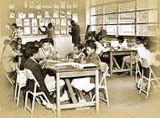
History of ANS Learners
Schools in Canada were never established to be egalitarian institutions
Established as segregated institutions, along religious lines and later, racial lines
Last segregated school in Canada was closed in Guysborough in 1983

Slide 6
The Legacy of Racial Discrimination
Historically, ANS have had:
  Little access to quality education
  Little decent employment opportunities
  To live in low income, with all of its negative consequences
  Lack of race relations policies
  Lack of culturally specific curriculum
  Need for teacher training and appropriate resources

Slide 7
Black Learners Advisory Committee
Black Educators Association formed in 1969
Advocates for study into the conditions of ANS Learners
Takes 20 years but in 1989 a Provincial Advisory Committee is appointed, renamed as BLAC
BLAC Report “demonstrates vividly, the realities of the African Nova Scotian experience in a discordant education system that is devoid of any effective policies that are essential and sympathetic to their needs” (BLAC, 1994, p. 13).
BLAC’s 30 recommendations were accepted by Government
CACE, ALI, ACSD, Anti-racist education policies, financial assistance to ANS post-secondary students, designated seats for ANS Learners

Slide 8
Response to the BLAC

Slide 9
Current State of ANS Learners
Despite desegregation, Black schools, poor schools, good schools, bad schools still exist in Nova Scotia . . . The legacy of catholic schools, protestant schools, I’m glad to report is almost over
Still lowest literacy rates are in largely Black Schools
IBM programme, TYP, Designated seats in education and NSCC programmes never have been fully filled
Drop out rates still higher, post secondary education uptake still lower

Slide 10
What Teachers Can Do
Let me ask the question . . .
Should “To Kill a Mockingbird” be Taught in Public Schools in Nova Scotia Today?
If no . . . Why not?
If yes . . . Could you teach it?
What is the comparable question in elementary education?

Slide 11
Beyond Cultural Competence
Cultural competence refers to an ability to interact effectively with people of different cultures. Cultural competence comprises four essential capacities:
  We must understand our cultural differences and similarities
  We must understand the social and cultural reality in which we work***
  We must cultivate appropriate attitudes towards cultural difference
  We must be able to generate and interpret a wide variety of verbal and non-verbal responses.
Cultural Competence is essential . . . And not an easy thing . . . Consider . . .

Slide 13
Racism Informed/Anti-racism
The Problem with Cultural Competence is that it doesn’t speak to the real problem . . . Racism and its living legacy
  We must understand the social and cultural reality in which we work***
What we mean to say is that to effectively work with historically oppressed peoples one must not only be aware of the “social and cultural reality”, one must be and be seen to be an active agent in the movement to challenge racism wherever it is found and be an active promoter of a Just Society

Slide 14
The Role of the Black Cultural Centre
Not just a repository of the artifacts of ANS history
A catalyst for the promotion of an ANS/afrocentric lens from which to view the challenges we have discussed.
A place from which all persons should leave not only with new information, but with a new perspective, a new lens

Slide 15
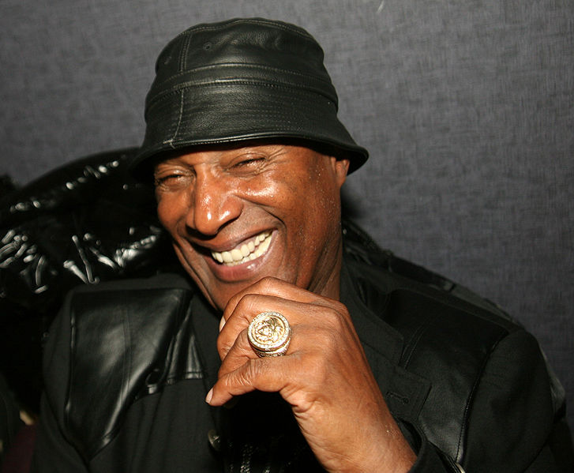
Q & A

