Slide 1
Africentricity: Imperative and Problematics
SAPACCY Symposium
June 8, 2022
By
Robert S. Wright, MSW, RSW

Slide 2

Who is Robert Wright?
A Social Work clinician
Former:
RR-Coord, DDSB
Ex.Dir. Ch & Yth Strat.
Ex. Dir.
Peoples’ Counselling Clinic
ANS Justice Institute
Taught in 4 MEd Africentric Cohorts
Pioneer of Impact of Race and Culture Assessments

Slide 3

Land Acknowledgement
Notes:
This graphic was produced by Patrick Hunter. Patrick is 2spirit Ojibway Woodland artist from the community of Red Lake. I was captivated by his work “Turtle Island” and purchased rights to the image to use in this presentation. Please do not reproduce this work for use in other presentations.
From Patrick’s website: Turtle island is what my people, the first nations of Canada, refer to as North America. She carries the people, and represented by the trees on her back are the 7 Grandfather teachings - love, humility, truth, bravery wisdom, respect, honesty. The blue tiles of her shell represent all of the fresh lakes and the black line represents our good soil for growing in North America. The tipi represents the people living amongs all of these things and that we’ve got to take good care of what we were given.

Slide 4
Land Acknowledgement
Turtle Island (North America) houses the traditional territories of hundreds of Indigenous peoples. Here, in Toronto the land we are meeting on is the traditional territory of many nations including the Mississaugas of the Credit, the Anishnabeg, the Chippewa, the Haudenosaunee and the Wendat peoples and is now home to many diverse First Nations, Inuit and Métis peoples.

Slide 5

Recognition, Justice, Development
Notes:
I would also like to acknowledge that we now in the 8th year of the International Decade for People of African Descent.
Group of fellows of the 2018 OHCHR Fellowship Programme for People of African Descent meet UN High Commissioner for Human Rights Michelle Bachelet (centre) in Geneva, Switzerland. Photo: OHCHR/Geneva
There are around 200 million people identifying themselves as being of African descent live in the Americas. Many millions more live in other parts of the world, outside of the African continent.
Whether as descendants of the victims of the transatlantic slave trade or as more recent migrants, they constitute some of the poorest and most marginalized groups. Studies and findings by international and national bodies demonstrate that people of African descent still have limited access to quality education, health services, housing and social security.

Slide 6
Towards Balance and Sustainability
Racism is North America’s Original sin, and European colonial presence has done irreparable harm to Indigenous Peoples and has disrupted the delicate balance necessary to live sustainably on the land.
Acts of reconciliation and reparation are necessary to make amends to the original stewards of Turtle Island to restore balance and sustainability and enable us all to live peacefully here.

Slide 7
Agenda
Introduction and Land Acknowledgement
Africentricity as Mental Health Treatment
Socio-cultural phenomena – Race and Addiction
History of African Canadian Substance Use and Trafficking
Advocacy as Intervention - Advocacy as Diplomacy
Lunch
Africentric Practice Q&A
Eco-mapping – Intervention Planning
Case study – Tyler in High School
Case study – Tyler in University
Deeper questions

Slide 8
Your Questions Before We Begin
No matter how brilliant my presentation is, if I don’t get to the burning questions you bring, I will have failed you. So I always ask:
What are your questions before we begin?

Slide 9
Why Africentricity as MH Practice?
People of African descent have suffered from over 400 years of colonialism, and disruption of culture, family and spirituality
This disruption is central to understanding the health of Black folks
Healing requires an Africentric Mental Health perspective.
“What does it mean when the tools of a racist patriarchy are used to examine the fruits of that same patriarchy? It means that only the most narrow parameters of change are possible and allowable.”*
*The Master's Tools Will Never Dismantle the Master's House, Audre Lorde

Slide 10
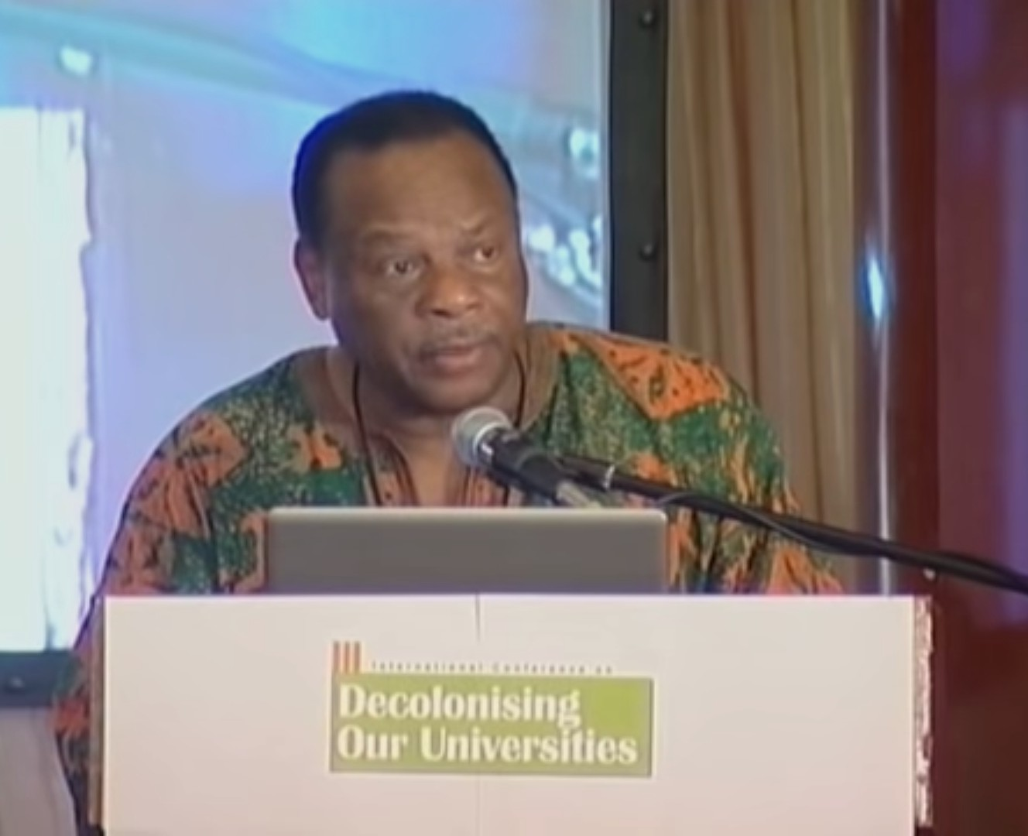
What is Africentricity?
The academic theory and approach to practice that centres African history and culture.
First “codified as a practice” by Molefi Asante in 1980
Nguzo Saba, Ma’at, Ubuntu often associated with Africentricity
Notes:
OCI Report 2013
Correctional Outcomes Taken as a whole, visible minority inmates appear to have better correctional outcomes than the total offender population. Over the last 7 years, on average, less than 5% of visible minority inmates have been readmitted within two years of their warrant expiry date. However, grouping visible minorities together masks important differences in these very distinct groups. For example, the case study of the experience of Black inmates under federal custody demonstrates that correctional outcomes are not as encouraging for this visible minority group when compared to others. When looking at diversity in corrections, it is important to understand what is happening in both relative and absolute terms. For example, the total number of institutional charges decreased by 5,731 in the last 4 years, which can be entirely attributable to the decrease in the number of charges against Caucasian inmates (- 6463). Meantime, institutional charges involving visible minority (+510) and Aboriginal (+222) inmates increased over the same period, even after accounting for increases in these populations. Black inmates are over-represented in use of force incidents, and, overall, visible minority inmates are over-represented in segregation placements.
Findings Black inmates are one of the fastest growing sub-populations in federal corrections. Over the last 10 years, the number of federally incarcerated Black inmates has increased by 80% from 778 to 1,403. Black inmates now account for 9.5% of the total prison population (up from 6.3% in 2003/04) while representing just 2.9% of the general Canadian population.8
Programming Despite being rated as a population having a lower risk to re-offend and lower need overall, Black inmates are 1.5 times more likely to be placed in maximum security institutions where programming, employment, education, rehabilitative and social activities are limited. They are also less likely to have their Custody Rating Scale score overridden in favour of a placement in a medium or even minimum security institution.
cf. A Comprehensive Study of Recidivism Rates among Canadian Federal Offenders CSC Publication No. R-426 August 2019

Slide 11
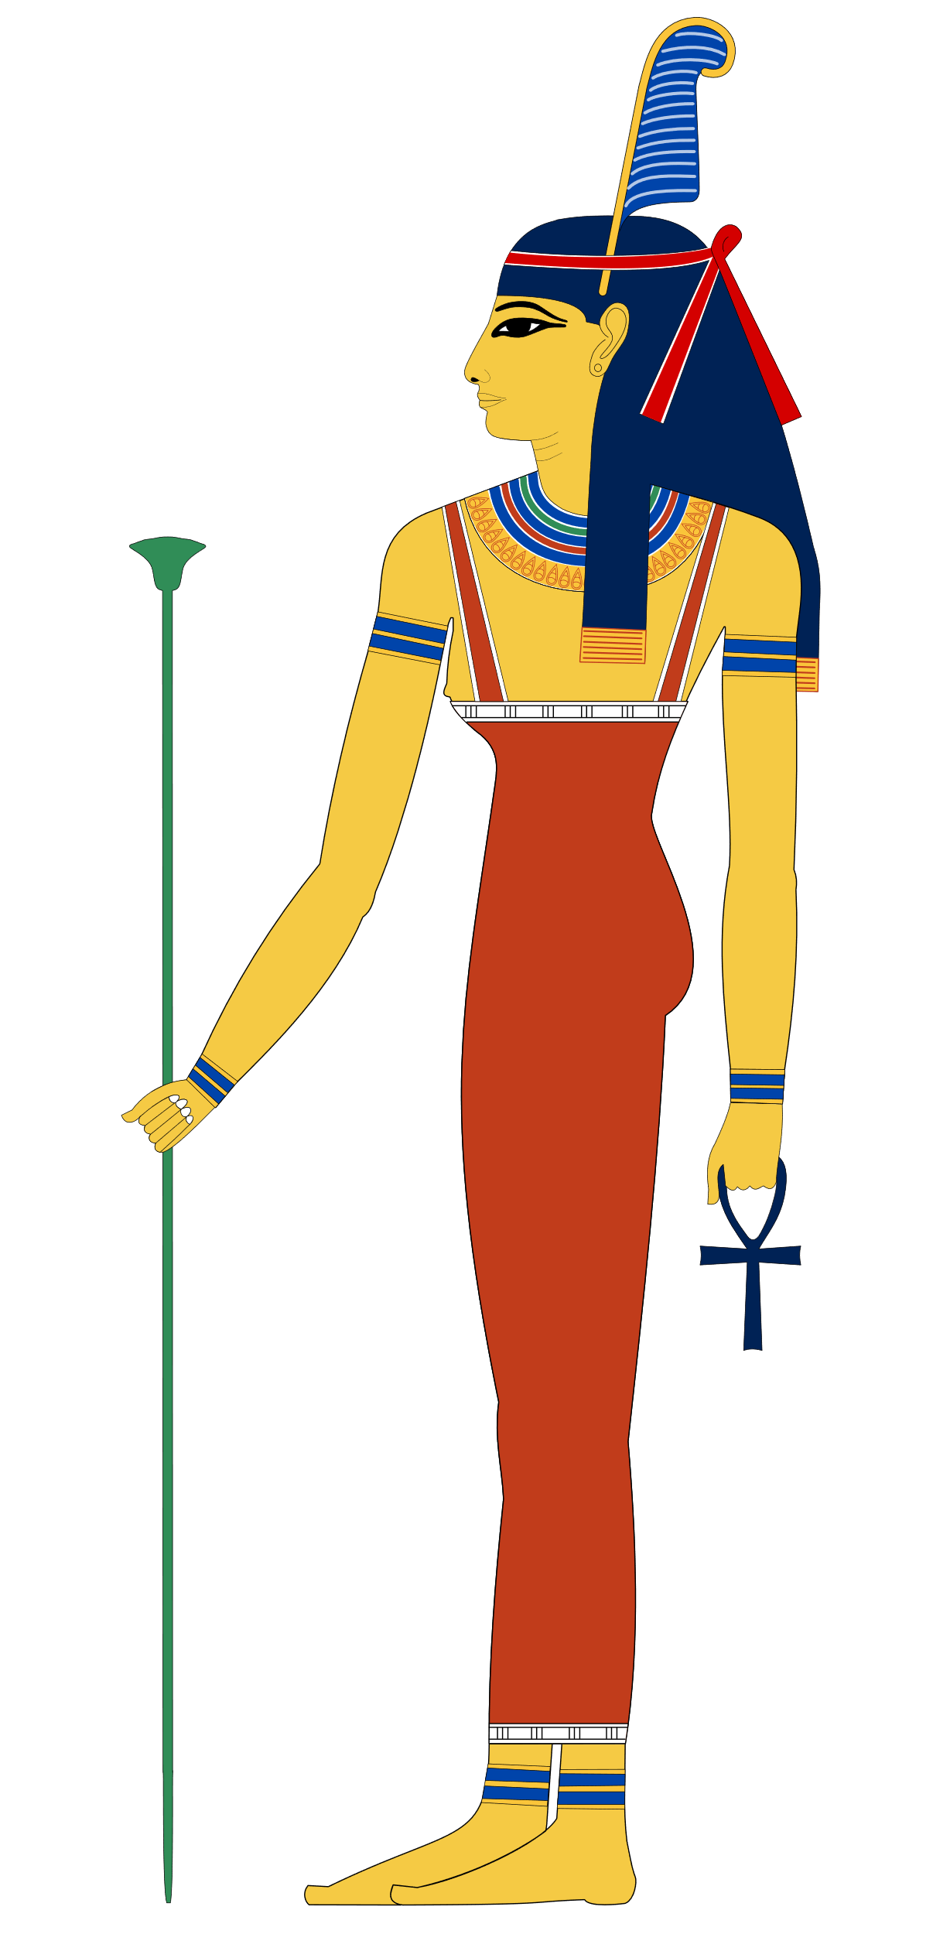
Ma’at
Ma’at refers to the ancient Egyptian concepts of truth, balance, order, harmony, law, morality, and justice.
The goddess, Ma’at, is the personification of those principles

Slide 12
Nguzo Saba
The seven principles of Kwanzaa, or Nguzo Saba were developed in 1965 by Mualana Karenga. Expressed in Swahili words, they were designed as expressions of fundamentals of African culture:
Umoja (Unity): To strive for and to maintain unity in the family, community, nation, and race.
Kujichagulia (Self-determination): To define and name ourselves, as well as to create and speak for ourselves.
Ujima (Collective work and responsibility): To build and maintain our community together and make our brothers' and sisters' problems our problems and to solve them together.
Ujamaa (Cooperative economics): To build and maintain our own stores, shops, and other businesses and to profit from them together.
Nia (Purpose): To make our collective vocation the building and developing of our community in order to restore our people to their traditional greatness.
Kuumba (Creativity): To do always as much as we can, in the way we can, in order to leave our community more beautiful and beneficial than we inherited it.
Imani (Faith): To believe with all our hearts in our people, our parents, our teachers, our leaders, and the righteousness and victory of our struggle.

Slide 13
Ubuntu and Collectivity
A Bantu word meaning “humanity”
Often translated as “I am because we are”
The greatest principle in African philosophy is the concept of communalism. It is central to African thought, culture, spirituality, and wellness.
This concept stands in contrast to Eurocentric concepts of individuality and centrality of “object”

Slide 14
Principles of Africentric MH Practice
Beyond Western constructions of mental health and treatment, Africentric Mental Health Practice must:
Construct and place treatment in a therapeutic community*
Assess racial and cultural identity development and needs (CFI+)
Educate about and treat the presence of racial trauma
Educate about and promote resistance to anti-Black racism
*Mkize, D.L.. (2003). Towards an Afrocentric approach to psychiatry. South African Journal of Psychiatry. 9. 3-6. 10.4102/sajpsychiatry.v9i1.128.

Slide 15
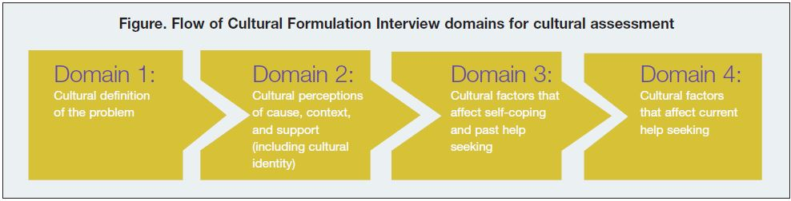
This Work Goes Beyond the CFI
CFI, developed over decades, provides a logical framework for cultural formulation
Establishes the necessity of understanding clients’ cultural narratives
Notes:
The development of Impact of Race and Culture Assessments falls in-line with other developments that are occurring in the mental health sector. The American Psychiatric Association’s DSM-V introduced the Cultural Formulation Interview (CFI) as a means to support clinicians as they assess and treat an increasingly diverse population. A link to the CFI is made available here:
https://www.psychiatry.org/File%20Library/Psychiatrists/Practice/DSM/APA_DSM5_Cultural-Formulation-Interview.pdf
It describes how in each of the 4 domains, clinicians can use questions to explore how the client understands the problem they are experiencing, what resources they have to assist them and what issues may aggravate or mitigate that problem from a cultural perspective. Though the CFI is a significant introduction to the Psychiatric world that racial context and client understanding and experience is key, it does not provide the depth of understanding the influence of a people’s history that may be prevalent in African Canadian communities. Neither does it model for clinicians how to ask explicit questions about a clients race, culture or ethnicity.

Slide 16
Addiction - A Socio-cultural Phenomenon
To understand, prevent and treat addiction we must locate it culturally and apply Africentric principles to it.
Wright, R. S, and Leader, T. (1997). Prevention and treatment of addictions among North American persons of African descent: another look at the disease model. Paper available from the authors.

Slide 17
Hx of African Substance Use Patterns
Precolonial, culturally bounded, ritualized use:
Fireside use by nomadic traders
Hospitality shown to honored guests
Religious and ritualistic use
Qat, Cannabis, fermented beverages, and a range of hallucinagins

Slide 18
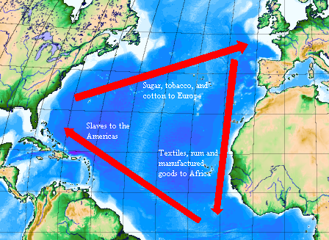
European Trade Triangle

Slide 19
Fallacy of Re-habilitation
Re-habilitation assumes use and addiction is the primary issue:
Assumes pro-social functioning pre-drug use
Assumes stopping use and returning to pre-use life is desirable and possible

Slide 20
Colonialism and Enslavement
Disrupted the culture of African peoples
Removed all cultural limits around substance use
Left a gaping “cultural hole”
Gangster hip-hop, criminal and drug culture may be substantially more functional and accessible than African culture
Given this, rehabilitation may not be desirable or possible

Slide 21
Racism and Substance Use and Trafficking
The Godfather https://www.youtube.com/watch?v=2D_zITtVJGA

Slide 22
Sociocultural Treatment Model
Critical curriculum that analyzes the past present and future of racialized and Aboriginal peoples
Use of culturally appropriate & competent facilitators
Group work focusses on community building and reestablishment of historical cultural norms and practices or the creation of new rituals (e.g. Kwanzaa)
Community development, political and social activism an essential component to acknowledge and address injustice
Promotes critical analysis and efforts to reclaim pre-European contact level of cultural cohesion

Slide 23

Advocacy – An Essential Intervention
Notes:
Black clients will always be at a significant disadvantage when it comes to navigating the various systems and supports that are attempting to serve them and their families. The nature of systemic racism is such that those services are not neutral. Founded in systemic racism, those systems and many of their practitioners will be hostile towards the Black client.

Slide 24
Racism’s Effect on All Peoples
On BIPOC Peoples
Historical Legacy of Underprivilege
Intergenerational Trauma
Post Traumatic Slave Syndrome**
The Advantage of Disadvantage
**Leary, J. (2017). Post traumatic slave syndrome : America's legacy of enduring injury and healing (Newly revised and updated ed.). Portland, Oregon]: Joy DeGruy Publications.

Slide 25
Racism’s Effect on All Peoples
On White People
White Privilege
White Supremacist Acculturation
Absence of Cultural Competence
White Empathy, White Guilt, White Fear*, White Fragility
*Spanierman, L. B., Todd, N. R., & Anderson, C. J. (2009). Psychosocial costs of racism to Whites: Understanding patterns among university students. Journal of counseling psychology, 56(2), 239–252. https://doi.org/10.1037/a0015432
On BIPOC Peoples
Historical Legacy of Underprivilege
Intergenerational Trauma
Post Traumatic Slave Syndrome**
The Advantage of Disadvantage
**Leary, J. (2017). Post traumatic slave syndrome : America's legacy of enduring injury and healing (Newly revised and updated ed.). Portland, Oregon]: Joy DeGruy Publications.

Slide 26
Keys to Effective Advocacy
An advocate must have influence – influence comes from relationship, knowledge, competence and trust
Advocating for Black clients in white systems requires diplomacy and skill
It may be essential to share knowledge you have in a way that doesn’t compromise the safety and privacy of the client
“Calling out” and protest are effective forms of advocacy that may not be available to some. Cultivate relationships with activists

Slide 27

LUNCH

Slide 28
Africentric Practice Q&A
Our Questions so far

Slide 29
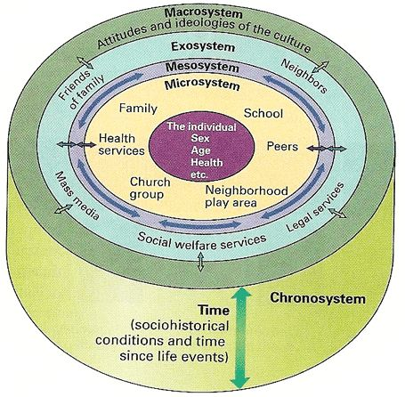
Eco-Mapping – Intervention Planning
Built on Bronfenbrenner’s Ecological Systems Theory
Self-in Context Mapping

Slide 30
Following Tyler – High School
Tyler is Black and grew up in public housing, oldest sibling of 3 boys, his single mom raised him. He was a promising athlete. He was coached and mentored by the best and the brightest young Black professionals in the community.
In grade 11, Tyler began smoking weed. By November he was a chronic pothead, waking and baking. His grades fell off and his (white) vice principal disqualified him from playing ball. His mother brought him into treatment. Tyler has come but is resistant.
What more do you need to know about Tyler? How do you begin to engage him and build a treatment plan?

Slide 31
Following Tyler – University
Tyler graduated, and with your programme’s support was successfully admitted to university. He plays ball, and though in his first year is making a significant contribution to the team
Tyler does not drink or use drugs, but while at a bar in his small college town he gets into a fight with the drunk college student that goaded him on.
Tyler gets charged with assault, is suspended from the team, leaves college and goes home where he gets back into “the life”, using and selling drugs.
What more do you need to know about Tyler? How do you begin to engage him and build a treatment plan?

Slide 32
Quentin – Tyler’s Younger Brother
Quentin grew up in Tyler’s shadow. He was not athletic but was “bookish”. He played the piano and organ and sang in the church choir. In high school, Quentin began smoking weed and doing “party drugs”. He would often go to raves with his friends.
Quentin started having sex with older men by the time he was in grade 11. He would hook up with men who would provide him with “sugar” and drugs to support their “partying”.
Quentin comes to therapy with his mother who is aware of his drug use and his declining engagement in school, but is not aware that he has sex with men.
Where do we start?!

Slide 33
Africentricity: Imperative and Problematics
SAPACCY Symposium
June 8, 2022
By
Robert S. Wright, MSW, RSW

Slide 34
Therapeutic Community
Western constructs of mental health treatment are largely personal and individual
Concepts of definition of the client, primacy of client and confidentiality are sometimes obstacles to Africentric practice
The necessity of therapeutic community can be explained and permissions sought to divert from the Eurocentric norms of individuality and confidentiality

Slide 36
Racial Identity Development
Stage | Age | Critical Issue | Process for Resolution | Significant Relationship(s) & Resources
Pre-school | 0-5yrs | comfort with visible racial differences | Adequate and enlightened physical care | primary physical caregiver
Early school | 5-9yrs | understanding of personal equality & competence | Facilitated success in social and academic pursuits | extended family members/school personnel
Early adolescence | 11- 14yrs | ability to appropriately negotiate racial issues with peers | Knowledge of history & politics of race | same race role models culturally specific & anti-racists education
Later adolescence | 15 - 18yrs | comfort with personal choices in context of race | Knowledge of family values re: race, sex, reproduction & vocation | peer group, same race role models, community censors & informal agents
Notes:
For the purposes of this training module I’m sharing a model of racial identity development that I prepared some years ago when I was challenged to assess the skills needed to effectively parent an African Canadian child. My research identified 4 critical issues that were essential to develop in childhood and youth to support a strong racial identity. The theory suggests that alongside the developmental path that Erikson suggests, African Canadians must additionally develop an increasing sense of who they are as Black people, and must develop this through the supports of external resources.
I wrote a small monograph describing this model in Reflections of African Canadian/American Identity Development from Birth to Later Adolescence:Towards a Framework for Guiding Interventions, in 2003. It is available on my website

Slide 37
Trauma - What is It?
Trauma is a type of injury one suffers when confronted with a dramatically threatening stimulus that overwhelms one’s ability to cope and/or integrate the feelings caused by the experience.
The term Trauma refers to both the event and the particular response to that event.

Slide 38
Trauma - A Useful Model

Slide 39
Intergenerational Trauma
Transgenerational trauma, or intergenerational trauma, is the psychological and sociological effects that the historical and collective trauma experienced by a group of people has on subsequent generations in that group
Intergenerational trauma is communicate through the generations by two mechanisms:
Social Learning, and;
Epigenetics

Slide 40
Resistance to Anti-Black Racism
I have developed a 6 point plan for my personal sanity preservation (you can be the judge of my success):
Identity
Competence/Excellence
Analysis
Independence
Process
Action
Wright, R. S. (2010). Keeping Sane as an African Canadian Working in White Institutions. Unpublished monograph. Halifax, Nova Scotia.

Slide 41
Resources
Bell, Peter (1992). Cultural Pain and African Americans Unspoken Issues in Early Recovery. Center City, MN: Hazelden
James, W. H. & Johnson, S. L. (1996) Doin’ Drugs: Patterns of African American Addiction. Austin, TX: University of Texas
Leary, J. D. (2005). Post Traumatic Slave Syndrome: America's legacy of enduring injury and healing, Portland, OR: Uptone Press.
Wright, R.S. (2003, Jan. 25). Reflections of African Canadian/American Identity Development from Birth to Later Adolescence: Towards a Framework for Guiding Interventions. Unpublished paper available from the author. Halifax, Nova Scotia.
Wright, R. S, and Leader, T. (1997). Prevention and treatment of addictions among North American persons of African descent: another look at the disease model. Paper available from the authors.

Slide 42
Africentricity As Mental Health Treatment
Considerations Offered
At
INDABA: A Gathering For Us, By Us,
About Us on Black Mental Health
May 5, 2021

