Slide 1
Essential Connections:
Historical Racial Trauma and Contemporary Treatment of African American Perpetrators and Victims
25th annual MASOC/MATSA Joint Conference
April 12-13, 2023
Robert S. Wright, MSW, RSW
Executive Director, The Peoples’ Counselling Clinic
A/Executive Director, African Nova Scotian Justice Institute

Slide 2

Who is Robert Wright?
Executive Director:
The Peoples’ Counselling Clinic
African Nova Scotian Justice Institute
Former:
Correctional Mental Health Worker (WSP)
Child Welfare Administrator
Ex. Dir. Child & Youth Strategy
Creator and Facilitator, ManTalk, InsideOut
Pioneer of IRCA (EPSR)

Slide 3
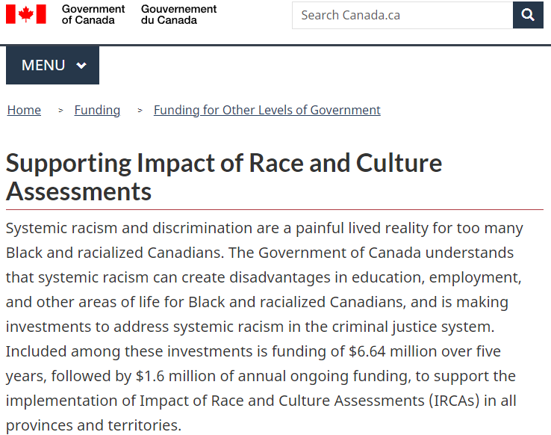

Slide 4

Warnings, Self-Care
This material will speak graphically about race, racism and a peoples’ history of sexual victimization and extreme racist treatment
Trigger and trauma warnings

Slide 5

Land Acknowledgement
Notes:
This graphic was produced by Patrick Hunter. Patrick is 2spirit Ojibway Woodland artist from the community of Red Lake. I was captivated by his work “Turtle Island” and purchased rights to the image to use in this presentation. Please do not reproduce this work for use in other presentations.
From Patrick’s website: Turtle island is what my people, the first nations of Canada, refer to as North America. She carries the people, and represented by the trees on her back are the 7 Grandfather teachings - love, humility, truth, bravery wisdom, respect, honesty. The blue tiles of her shell represent all of the fresh lakes and the black line represents our good soil for growing in North America. The tipi represents the people living amongs all of these things and that we’ve got to take good care of what we were given.
Turtle Island is one of the names that Indigenous people call North America. It houses the traditional territories of hundreds of Indigenous peoples. I am from Mi’kma’ki is the traditional and unceded territories of the Mi’kmaq people. We are currently in Toronto, the traditional territory of many nations including the Mississaugas of the Credit, the Anishnabeg, the Chippewa, the Haudenosaunee and the Wendat peoples. We must acknowledge that the health and prosperity that is enjoyed by Canadians comes from this land.
Sadly, racism is North America’s Original sin, and European colonial presence has done irreparable harm to Indigenous Peoples and has disrupted the delicate balance necessary to live sustainably on the land.
Acts of reconciliation and reparation, both symbolic and substantial are necessary to make amends to the original stewards of Turtle Island and to restore balance and sustainability to our ability to live here.

Slide 6
Workshop Objectives
WHAT:
Deeper Cultural Competence working with Black perpetrators and victims
Legal origins of anti-Black racism and its consequences
Racial trauma and sex offending and victimization
Engaging Black clients by making race issues explicit
HOW:
Presentation of material
Curiosity and conversation

Slide 7
Context: NS Mass Casualty Commission
“The perpetrator was a white, wealthy male in his early 50s. . . . a denturist”
On April 18, 2020 he shot and killed 22 persons, wounding 3 others: The worst mass murder in Canadian history.
“. . . the perpetrator used his Halifax dental office to sexually exploit marginalized individuals, including those who self-identified as sex workers. He exploited African Nova Scotian women . . . and was known to provide cash compensations for referrals and exchange dental work for sex.”

Slide 8
Why?
People of African descent are overrepresented as victims and perpetrators of sexual violence
People of African descent are less likely to report their victimization or to seek and benefit from treatment if perpetrators
There is a dearth of data on typologies; culturally specific treatment models; the impact of culture, race and racism on treatment
We need safe spaces to imagine and discuss how we as individuals and as a sector address the needs of Black clients

Slide 9
Cultural Competence: Definition
Cultural competence refers to an ability to interact effectively with people of different cultures. Cultural competence comprises five essential capacities:
We must understand our own cultural positions and how they differ from and are similar to others (critical cultural self-analysis)
We must understand the social and cultural reality in which we live and work and in which our clients live and work
We must cultivate appropriate attitudes towards cultural difference
We must be able to generate and interpret a wide variety of verbal and non-verbal responses (client centred interviewing)
We must understand structural oppression and demonstrate awareness and commitment to social justice

Slide 10
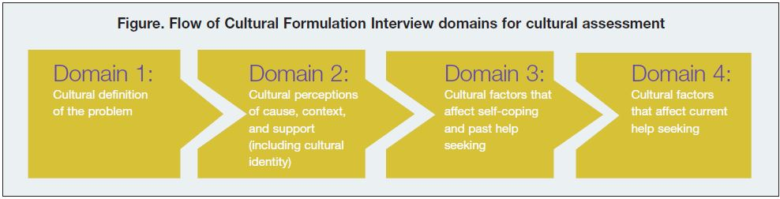
This Work Goes Beyond the CFI
CFI, developed over decades, provides a logical framework for cultural formulation
Establishes the necessity of understanding clients’ cultural narratives
Notes:
The development of Impact of Race and Culture Assessments falls in-line with other developments that are occurring in the mental health sector. The American Psychiatric Association’s DSM-V introduced the Cultural Formulation Interview (CFI) as a means to support clinicians as they assess and treat an increasingly diverse population. A link to the CFI is made available here:
https://www.psychiatry.org/File%20Library/Psychiatrists/Practice/DSM/APA_DSM5_Cultural-Formulation-Interview.pdf
It describes how in each of the 4 domains, clinicians can use questions to explore how the client understands the problem they are experiencing, what resources they have to assist them and what issues may aggravate or mitigate that problem from a cultural perspective. Though the CFI is a significant introduction to the Psychiatric world that racial context and client understanding and experience is key, it does not provide the depth of understanding the influence of a people’s history that may be prevalent in African Canadian communities. Neither does it model for clinicians how to ask explicit questions about a clients race, culture or ethnicity.

Slide 11
Black Perpetrators and Victims
27% of adjudicated sexual abusers in US are Black (Black people make up 13.6% of the US population - RAINN)
African American girls and women . . . experienced higher rates of rape and sexual assault than white, Asian, and Latina . . . (U.S. DOJ Bureau of Justice Statistics, “Female Victims of Sexual Violence, 1994-2010,” 2013)
Black victims of sexual violence are dramatically less likely to report their victimization than their white peers (cf. Mass Casualty Commission of Nova Scotia, 2023)
Abusive sexual practices of “pimps” is nearly unstudied (Stalans and Finn, 2019)

Slide 12
Our Deficit Is About Systemic Racism
To improve service delivery to Black clients we will need to address systemic racism. We will need to:
Understand that it exists
Know the history of the affected people
Understand the impact on the individual
Create individualized responses that address effects
Notes:
This is a proposal

Slide 13
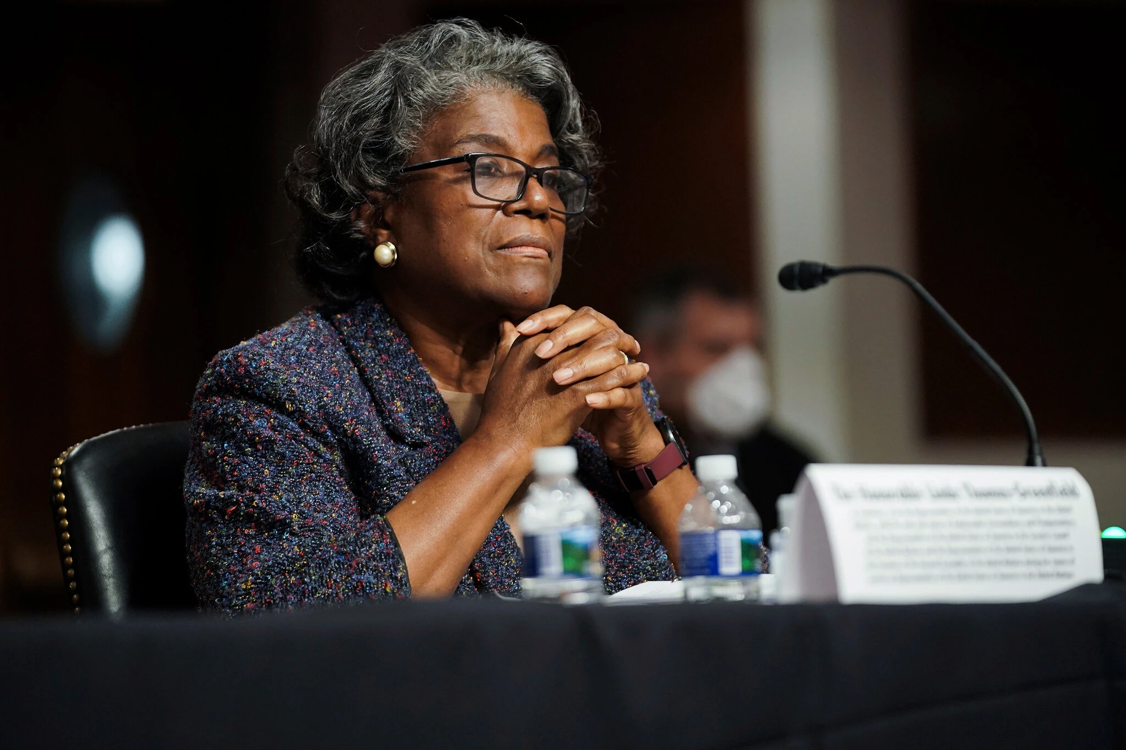
Systemic Racism Exists
“Let us expose the racism and racial discrimination endemic to every society, around the globe. Let us press forward, to root out that discrimination and remove the rot from our foundations.”
U.S. Ambassador to the United Nations, Linda Thomas-Greenfield
Notes:
Fact Sheet: U.S. Efforts to Combat Systemic Racism | The White House

Slide 14
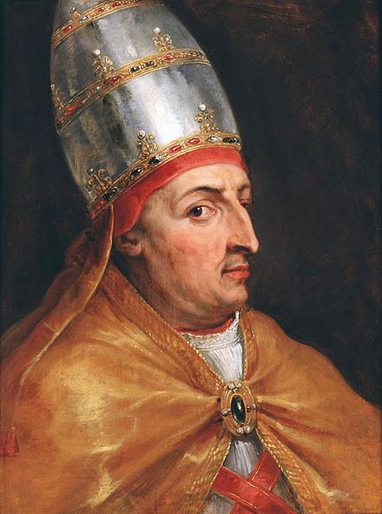
Know the Legal History
Dum Diversas – 1452
Papal Bull by Pope Nicholas V authorizing Portugal to conquer and enslave Saracens and North Africa
Notes:
The seeds of the dehumanization, enslavement and continuing marginalization of people of African descent has a deep history. Prior to the crusades (1095 – 1492CE), there was a general recognition in the western world that African peoples were indeed people. During this period, many of the royal courts in Europe had representatives from African nations. Though slavery and indenture existed, it was not the kind of perpetual, multigenerational, chattel slavery that would exist and take force during the transatlantic African slave trade.
This new form of slavery came into existence and began to take shape legally in the mid 1400s. In 1452 Pope Nicholas V authorized the king of Portugal, Afonso V to use a new tactic during the war that we commonly refer to as the crusades. Dum Diversas was a Papal Bull or decree that gave the Portuguese the legal right to conquer, dispossessed, and consigned to “perpetual servitude” any non Christian people. This Decree essentially denied the humanity of any non Christian population and empowered European nations with the tools necessary for the form of empire expansion and colonization that was to follow. The enslavement of Africans and the dispossession and genocide of aboriginal peoples in North and South America, Australia and other places was to follow.
It is important to note that the religious, political, and legal marginalization of African and aboriginal peoples all have their roots in this papal Decree. For more information see: https://en.wikipedia.org/wiki/Dum_Diversas

Slide 15
History of Black Sexual Victimization
In Slavery
Black women, men and children sexually abused by slavers
Black persons sexually abused by forced mating
Black bodies eroticized and fetishized
Reproductive abuse of Black women (forced abortion, infanticide, commodofication of children)
Genital torture and mutilation well documented
Lynching almost always occompanied by sexual humiliation and genital mutilation
(cf. Foster. T. (2011). The Sexual Abuse of Black Men under American Slavery. Journal of the History of Sexuality 20, 2. pp. 445-464)

Slide 16
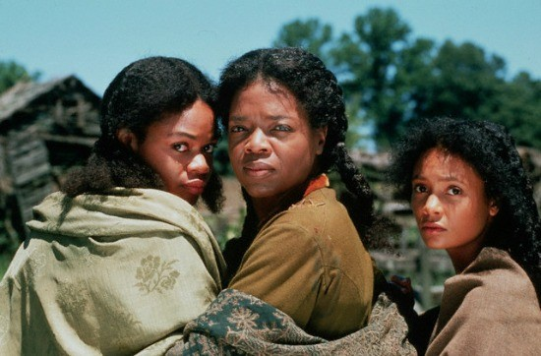
Notes:
Themes of sexual violence in Beloved and To Kill a Mockingbird

Slide 17
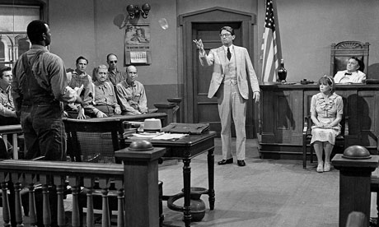
Notes:
Themes of sexual violence in Beloved Toni Morrison, and To Kill a Mockingbird, Harper Lee

Slide 18

Notes:
Iceberg slim most widely read African American Author!

Slide 19

Notes:
Lil Wayne’s story of sexual victimization

Slide 20
Youth Onset of Trafficking Behaviour
85% of sex traffickers were male and 65% were black.
Family involvement, either as traffickers or sex workers, and community exposure are common entries into pimping
1/3 of one sample reported they began trafficking during adolescence (ages 14-17).
some reported they were recruited by the women they trafficked.
(Sex Traffickers and Buyers of Commercially Sexually Exploited Children, California Sex Offender Management Board, 2020)

Slide 21
Dennis
14yr old African Canadian youth, hanging out in the cafeteria practicing his macking/pimping game:
Dennis: Hey girl, where’s that $10.00 you owe me?
Tammy: (giggling) Dennis, you know I don’t owe you any money!
Dennis: Yes you do girl! Don’t you remember? Well, at least you can buy me lunch.
Tammy: (still giggling) Okay Dennis, what do you want?

Slide 22
Racism’s Psychological Effect on Peoples
On BIPOC Peoples
Historical Legacy of Economic Displacement
Intergenerational Trauma
Post Traumatic Slave Syndrome**
**Leary, J. (2017). Post traumatic slave syndrome : America's legacy of enduring injury and healing (Newly revised and updated ed.). Portland, Oregon]: Joy DeGruy Publications.

Slide 23
Socio-economics and Trauma - PTSS
Intergenerational trauma is transmitted through 2 primary methods: Social Learning and Epigenetics
Three elements of PTSS
Vacant esteem
Marked propensity for anger and violence
Racist socialization and internalized racist beliefs
The traumas suffered by Black peoples are enmeshed with and somewhat defining of Black identity. Untangling them may interfere with positive racial affiliation (cf. Herbert Kohl - “I won’t learn from you” and Peter Bell’s concept of Cultural Pain)
Notes:
"I won't learn from you" is Herb Kohl's now-classic essay about the phenomenon of "not-learning," or refusing to learn, which takes place when a student's intelligence, dignity, or integrity is compromised by a teacher, an institution, or a larger social mindset.
In my practice I’ve encountered the phenomenon of “I won’t heal with you.”

Slide 24
Shifting Calibration of the HPA Axis
Affect Response
Stimulus

Slide 25
Shifting Calibration of the HPA Axis
Affect Response
Stimulus
Normal Stimulus/
Proportionate Response

Slide 26
Shifting Calibration of the HPA Axis
Affect Response
Stimulus
Normal Stimulus/
Proportionate Response
Normal Stimulus/
Miscalibrated Response

Slide 27
Racism’s Psychological Effect on Peoples
On White People
White Privilege
White Supremacist Acculturation
White Empathy, White Guilt, White Fear*, White Fragility
*Spanierman, L. B., Todd, N. R., & Anderson, C. J. (2009). Psychosocial costs of racism to Whites: Understanding patterns among university students. Journal of counseling psychology, 56(2), 239–252. https://doi.org/10.1037/a0015432
On BIPOC Peoples
Historical Legacy of Economic Displacement
Intergenerational Trauma
Post Traumatic Slave Syndrome**
**Leary, J. (2017). Post traumatic slave syndrome : America's legacy of enduring injury and healing (Newly revised and updated ed.). Portland, Oregon]: Joy DeGruy Publications.

Slide 28
White Supremacist Acculturation
White therapists almost always suffer from “the disadvantage of privilege”
They will “embody” the colonial and racist structures that harmed and continue to threaten their Black clients
Limited understanding and the perpetration of microaggressions* are almost certain
Making race transparent and seeking competent consultation will help to mitigate this problem

Slide 29
Microaggression
A microaggression is any comment or gesture that has an “othering” or minimizing affect on a person who has experienced historical marginalization. Such comments may highlight or suggest that a person doesn’t belong; is different or odd; suggests that their experience with discrimination is imaginary or exaggerated; or offers a “false equivalency”.

Slide 30
Addressing Race in Therapy
Take race identifying information at intake
Address the racial location of the therapist in the first session
Explain relevance of race in treatment across the CFI domains and beyond
Acknowledge the living legacy of colonialism
Screen for Black male sexual victimization
Promote deeper, healthy racial affiliation and identification
In the absence of same-race-role models the therapist may need to serve as healthy identity development mentor
Notes:
from the historical influence of racism on the issue, race as part of the social context that defines the problem, lack of research and knowledge of racial dynamics in sex offending, racial definitions of what “health” looks like, presence (or absence) of culturally specific resources, etc.

Slide 31
Racial Identity Development (Wright, 2003)
Stage | Age | Critical Issue | Process for Resolution | Significant Relationship(s) & Resources
Pre-school | 0-5yrs | comfort with visible racial differences | Adequate and enlightened physical care | primary physical caregiver
Early school | 5-9yrs | understanding of personal equality & competence | Facilitated success in social and academic pursuits | extended family members/school personnel
Early adolescence | 11- 14yrs | ability to appropriately negotiate racial issues with peers | Knowledge of history & politics of race | same race role models culturally specific & anti-racists education
Later adolescence | 15 - 18yrs | comfort with personal choices in context of race | Knowledge of family values re: race, sex, reproduction & vocation | peer group, same race role models, community censors & informal agents

Slide 32

Michael - From the Wire
Michael is a 14 yr old African American male. His mother suffers from addiction. His step-father repeatedly sexually assaulted him before being incarcerated for unrelated offenses. 3 years later his abuser is released from prison and returns to the home. Michael, a talented, bright young man, retreats into depression and anger. Rather than turning to teachers and social workers (the threat that he and his younger brother would come into care and be separated existed), he turns to enforcers on the street and arranges for the murder of his stepfather. This act cements his hard entry into street life.
Notes:
I had a client very similar to Michael . . . I lost him . . . my

Slide 33
Notes:
Towards a culturally responsive model of sex offender and victimization treatment

Slide 34
Revisit Cultural Competence
Cultural competence refers to an ability to interact effectively with people of different cultures. Cultural competence comprises five essential capacities:
We must understand our own cultural positions and how they differ from and are similar to others (critical cultural self-analysis)
We must understand the social and cultural reality in which we live and work and in which our clients live and work
We must cultivate appropriate attitudes towards cultural difference
We must be able to generate and interpret a wide variety of verbal and non-verbal responses (client centred interviewing)
We must understand structural oppression and demonstrate awareness and commitment to social justice

Slide 35
Revist the CFI
CFI, developed over decades, provides a logical framework for cultural formulation
Establishes the necessity of understanding clients’ cultural narratives
Notes:
The development of Impact of Race and Culture Assessments falls in-line with other developments that are occurring in the mental health sector. The American Psychiatric Association’s DSM-V introduced the Cultural Formulation Interview (CFI) as a means to support clinicians as they assess and treat an increasingly diverse population. A link to the CFI is made available here:
https://www.psychiatry.org/File%20Library/Psychiatrists/Practice/DSM/APA_DSM5_Cultural-Formulation-Interview.pdf
It describes how in each of the 4 domains, clinicians can use questions to explore how the client understands the problem they are experiencing, what resources they have to assist them and what issues may aggravate or mitigate that problem from a cultural perspective. Though the CFI is a significant introduction to the Psychiatric world that racial context and client understanding and experience is key, it does not provide the depth of understanding the influence of a people’s history that may be prevalent in African Canadian communities. Neither does it model for clinicians how to ask explicit questions about a clients race, culture or ethnicity.

Slide 36
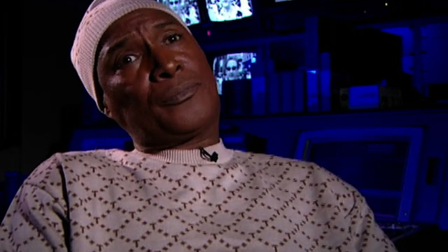
Q & A

Slide 37
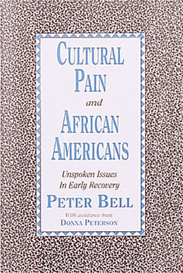
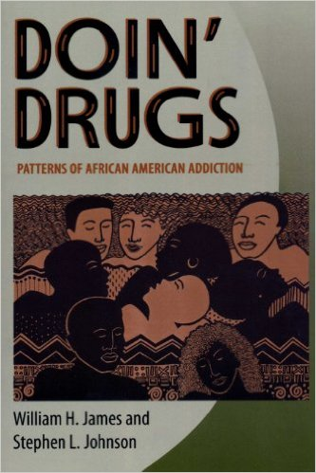
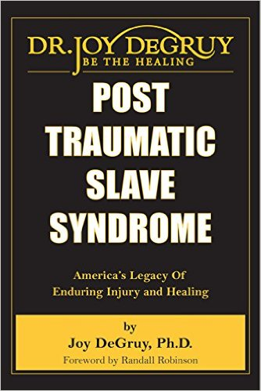
Resources Describing Cultural Effects and Patterns

Slide 38
Communicating About Culture
Cultural competence requires the ability to comfortably and competently ask clients about cultural issues that may be a consideration in the context of your work with them. Consistent with expectation of CFI

Slide 39
Acknowledgements
My late mother
For providing the safety net of her sofa and the confidence that comes from being loved ferociously
My daughter and my son
For the sacrifices they make that enables me to do this work
My pantheon of mentors, models, and ancestors
My sisters
For their constant love and care (though they threaten to work me to death!)
My lovers, including my ex-wife
For walking with me on my own journey of racial and sexual healing

Slide 40
Bell on Cultural Pain
“Feelings of insecurity, confusion, uncertainty, and inadequacy are all examples of cultural pain. The history of slavery, racism, and segregation, added to today's conflicting expectations and pressure of being a(n) . . . African American, all combine to create cultural pain. By addressing self-identity issues, you can begin to develop new coping skills that enhance your own recovery.” (From Hazelden.org’s description of the Bell text)
The added shame of emasculating under-employment, the increased stigma of homophobia in the African American community, the confusion and struggle to accept or reject “the hustle”, perceptions of selling out when one “goes straight”

Slide 41
Treatment Relevance
Responsivity to community issues enhances attachment to and effectiveness of treatment:
Diversity within communities of color
How sexual violence is understood
Cultural response to sexual violence
Influences of family, community, and faith
Legal status
Distrust of white systems
Trauma and adverse economic and health outcomes
Barriers to access
Resilience
(Ohio Alliance to End Sexual Violence)

