Slide 1
Runaways, Truants and the Knuckleheads Who Harbour Them: Eco structural and harm reduction interventions with difficult teens
Robert S. Wright, MSW, RSW
Social Worker in Private Practice
Presented to
Child Welfare Social Workers in Halifax
November 14, 2012

Slide 2
Who is Robert S. Wright?
BSW, MSW Child & Family Mental Health
PhD Student, Sociology, Dalhousie
SW Private Practice since 1990
Forensic, Sex Offender Specialist
Background in anti-poverty, education, child welfare, mental health, forensics, cultural competence
Former E.D. Of Child Welfare Agency
Former E.D. Child & Youth Strategy
Bona Fide Knuckleheadologist

Slide 3
Who are the Kids We’re Talking About?
You know them!
Run away from home and school
Engage in risky behaviours (drugs, alcohol)
Create havoc in communities (delinquency)
End up in increasingly expensive and inappropriate placements
Difficult Kids Are Hard to Manage!

Slide 4
The Problem
Traditional Methods Ineffective
Rescue/Child welfare method great for little kids, not so good for adolescents
Kids are often bad fits for foster care
Policing model slow and unresponsive
Unduly criminalizes the acting out behaviour of children in need

Slide 5
The Problem 2
Traditional Clinical Focus is Limited
Kids seen as the problem, defective, problemed, need to be fixed
Kids therefore focus of our attention/intervention
Kids are resistant so we spend time chasing and attempting to contain them to treat them

Slide 6
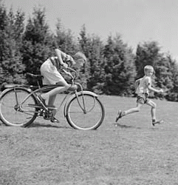
The more we chase, the more they run!

Slide 7
Harm Reduction in Child Welfare
Policies, programmes or practices designed to reduce the harm caused by risky behaviours
Controversial in child welfare because of perceived complicity with harmful behaviour
Useful in maintaining relationships with highest risk youth
Creates a power shift in relationships with difficult youth that challenges their decisions

Slide 8
Example
17 year old youth left placement refused other locations
Lived in a tent in the woods
We arranged meals at a local cafeteria
Social worker contacted him weekly to maintain relationship
Supported youth through transition to IA, helped him explore what he wanted and needed

Slide 9
Obstacles to Harm Reduction
Fear for youth’s immediate safety
Fear for youth’s longer term outcome
Perceptions of liability on the part of social workers

Slide 10
The Eco Structural Approach
Difficult youth need systems interventions
MST widely seen as effective (Henggeler)
Individual, family, community work indicated (McGoldrick)
Resiliency theory identifies multiple domains for intervention (Ungar)

Slide 11
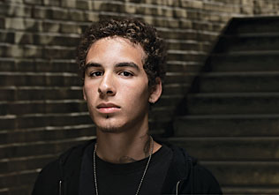
Old Model Just Looked at Youth

Slide 12
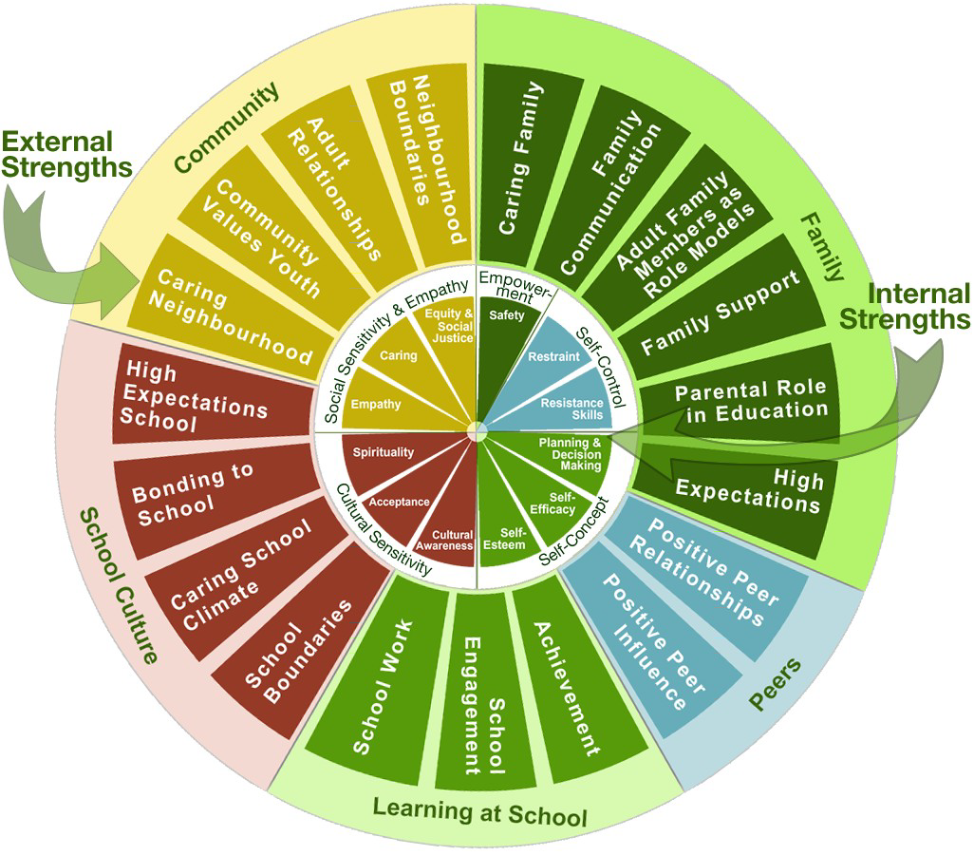
Newer Models Look at the whole system

Slide 13
Sounds Good in Theory, How Does it Work?
Case Example: Runaways and Truants
Kids jigging school, coming home late
Rash of teenage drinking and drug use
Epidemic of inappropriate sexual behaviours
Kids coming home late or running away for days (from home, foster home or group home)

Slide 14
Focus on the System
Reign in the Knuckleheads who harbour
After taking several children from several such homes, developed a plan
Contacted, informed and engaged police
Identified homes that harboured
Visited each to engage in “helping”
Provided education re: Crim. Code and CFSA violations
Solicited “invitations” to return occasionally

Slide 15
By What Authority?
CFSA (NS) s.92 Offences and penalties - No interfering with a child in the Care of an Agency
Criminal Code, R.S.C. s.280-281 - No harbouring kids against parents’ will -abduction
Moral/Community/Parental/Paternal Authority!

Slide 16
Outcomes
Reduction in young truants
Reduction in curfew violations and runaways from families and care
Increased sense of attachment to troubled youth
Improved relations with knuckleheads who were ready sources of “intelligence”
Increased sense of empowerment among parents, care givers and workers
Returned sense of “community ownership of welfare of children”

Slide 17
Obstacles to Eco-Structural Work
Confidentiality?
Job description/role/function/union?
Worker Safety?
Cooperation of partners?
Legality?
Service contracting of this work?

Slide 18
Implications for Child Welfare Practice
“Clinical Casework” model may need to open up to more collaborative/community/group work
Family work may be indicated for kids in permanent care
Concepts of confidentiality may need to be adjusted for certain work
Higher tolerance of risk may be necessary for youth in care

Slide 19
Q & A

Slide 20
Runaways, Truants and the Knuckleheads Who Harbour Them: Eco structural and harm reduction interventions with difficult teens
Robert S. Wright, MSW, RSW
Social Worker in Private Practice
Presented to
Child Welfare Social Workers in Halifax
November 14, 2012

Slide 21
Leadership is Necessary!
Principles of Catalytic Leadership
Innovation: Solutions to complex problems require collaboratively birthing new ideas, not simply debating and selecting amongst the old.
Empowerment: The best solutions are created by accepting and aligning the offerings of all critical stakeholders and knowledge holders.
Ownership: People give time, energy and commitment in proportion to their degree of ownership.
Inclusion: Participation is the straightest road to ownership.
(Taken from “The Role of the Public Sector in Addressing Tough Community Problems.” Jim Ellsworth, PSEPC)

