Slide 1
Breaking-down the Silos
“Creating active, healthy communities through collaboration”
February 23, 2012
Gordon R. Snow Building
Robert S. Wright, MSW, RSW
www.robertswright.ca

Slide 2
Collaboration:
Differential Definition
Collaboration is a way of working together that exists at the far end of a continuum that includes:
  Cooperation
  Coordination
  Collaboration
(The following work is adapted from “Collaboration: What Makes it Work, 2nd Ed.”)

Slide 3
Why Collaboration
Since the 1970’s there has been recognition that society is increasingly diverse. Acknowledging this diversity, and the complexity that it brings to our understanding of social issues and social problems awakened us to the need for more complex responses.

Slide 4
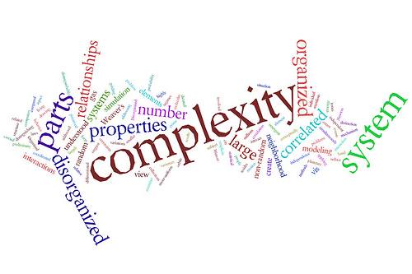
Complexity Requires Complexity

Slide 5
Collaboration:
Differential Definition
Cooperation is characterized by informal relationships that exist without any commonly defined mission, structure or planning effort

Slide 6
Collaboration:
Differential Definition
Coordination is characterized by more formal relationships and an understanding of compatible missions. Though joint planning may be done, authority still rests with the individual units

Slide 7
Collaboration:
Differential Definition
Collaboration connotes a more durable and pervasive relationship. Participants are brought into new relationships which exercise authority independent of their separate functions. They work together under a common mission.

Slide 8
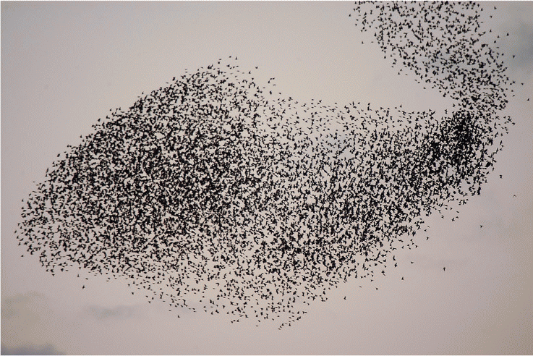
Cooperation:
Like a Flock of Starlings

Slide 9

Coordination:
Like a Flock of Geese

Slide 10

Collaboration:
Something Slightly More Powerful

Slide 11
Collaboration:
Six Essential Factors
Conducive environment
Prepared members
Defined process and structure
Functional communication
Well articulated purpose
Sufficient and skilled resources

Slide 12
The Environment
  Hx of Collaboration or Cooperation
  Group Seen as a Legitimate Leader
  Favourable Political and Social Climate
Membership
  Mutual Respect, Understanding*, Trust
  Appropriate Cross Section of Members
  Collaboration Serves Self-interest
  Ability to Compromise
Process and Structure
  Members “own” process and product
  Multi-layered participation
Flexibility
  Clear Roles and Policies
  Adaptability
  Appropriate Pace of Development
Communication
  Open and Frequent Communication*
  Informal Relationships and Communication Link
Purpose
  Concrete, Attainable Goals and Objectives
  Shared Vision*
  Unique Purpose
Resources
  Sufficient Funds, Staff, Materials and Time
  Skilled Leadership*

Slide 13
Collaboration:
Six Essential Factors
Conducive environment
Prepared members
Defined process and structure
Functional communication
Well articulated purpose
Sufficient and skilled resources

Slide 14
Collaboration Leadership
Must be Catalytic
Innovation: Solutions to complex problems require collaboratively birthing new ideas, not simply debating and selecting amongst the old.
Empowerment: The best solutions are created by accepting and aligning the offerings of all critical stakeholders and knowledge holders.
Ownership: People give time, energy and commitment in proportion to their degree of ownership.
Inclusion: Participation is the straightest road to ownership.
(Taken from “The Role of the Public Sector in Addressing Tough Community Problems.” Jim Ellsworth, PSEPC)

Slide 15
Examples
Cumberland County Collaborative
  When it works, it transforms communities
Child and Youth Strategy
  Success in the face of major structural barriers

Slide 16
End

Slide 17
Breaking-down the Silos
“Creating active, healthy communities through collaboration”
February 23, 2012
Gordon R. Snow Building
Robert S. Wright, MSW, RSW
www.robertswright.ca

