Slide 1
Parenting African Nova Scotian Children
Robert S. Wright, MSW, RSW

Slide 2
The Job of Parenting
Parenting “ain’t easy”
Turn love into parenting behaviour designed to produce healthy successful kids
We do all that in the face of our own imperfections
And the child is a moving target!

Slide 3
The Laser Beam of Love
Loving
Caring
Affection
Objective
Parenting Tasks
Maintaining Stable Housing
Consistent Limits
Nutrition
Educational Preparation
Child’s Outcome
Independence
Self-control
Affectionate
Parent’s
Experiences
As Child
Parent’s
Emotional
Health
Parent’s Adult
Relationships
&
Experiences

Slide 4
Children are Moving Targets
From birth to adulthood (actually until we are in their old age) people go through numerous stages
These stages are characterized by neurological, emotional and physical changes
Every time the child changes what they need from their parents change. That’s why parenting strategies that once worked fail after a time

Slide 5
Erik Erikson
Educator and Analyst, colleague and friend of Anna Freud
Developed 8 stages of psycho-social development
At each stage society demands things of us
Our ability to meet those demands creates a “crisis”. We meet the crisis and grow healthy and strong, fail and our development is delayed

Slide 6
Erikson’s Model
Age / Stage | Crisis | Process | Parenting Role
Infancy (birth to two years) | Basic trust versus basic mistrust | Mutuality with caregivers | Competent physical care Interactive play Facilitate safe interaction with others
Toddlerhood (two to four years of age) | Autonomy versus shame and doubt | Imitation | Promoting physical and vocal imaginative play Establishing routine Reading Toilet training
Early School Age (four to six years of age) | Initiative versus guilt | Identification | Modeling family culture Facilitating & supervision of group play resolving early struggles
Middle School Age (six to twelve years | Industry versus inferiority | Education | Supporting academic success
Early Adolescence (twelve to eighteen years of age) | Group identity versus alienation | Peer pressure | Facilitating interaction with peers
Later Adolescence (eighteen to twenty-two years of age) | Individual identity versus identity confusion | Role experimentation | Supporting the Child through changing roles

Slide 7
Lifetime Knowledge
Amount Learned
Birth 0____________________50____75____100%
1st year of life 2nd year 3rd year+

Slide 8
Attachment: The Foundation
Quiescence
Need
Displeasure
Satisfy Need
Trust
Security
Attachment

Slide 9
Racial Identity
Culture is a social determinant of health
Having a strong sense of who you are, a strong sense of racial identity is important for our healthy development
Racial identity develops like other aspects of our development in stages over our lifetimes

Slide 10
Wright’s Model of Racial Identity Development
Age / Stage | Critical Issue | Process | Resources & Role
Preschool (zero to five years) | comfort with visible racial differences | Adequate and enlightened physical care | primary physical caregiver
Early School Age (five to nine years) | understanding of personal equality & competence | Facilitated success in social and academic pursuits | extended family members/school personnel partnership
Early Adolescence (eleven to fourteen years) | ability to appropriately negotiate racial issues with peers | Knowledge of history & politics of race | same race role models, culturally specific & anti-racists education
Later Adolescence (fifteen to eighteen years) | comfort with personal choices in context of race | Knowledge of family values re: race, sex, reproduction & vocation | peer group, same race role models, community leaders & informal agents

Slide 11

Physical Care

Slide 12

Success

Slide 13

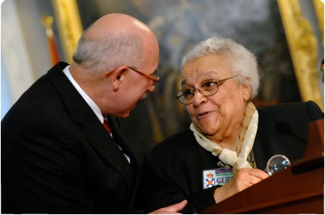
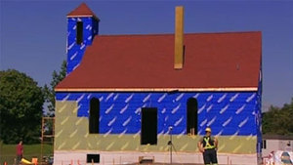
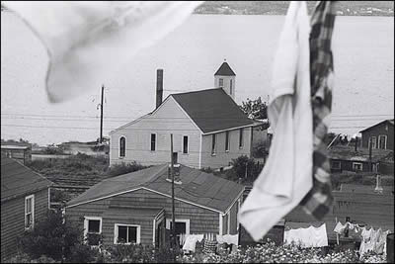
History and Politics of Race

Slide 14
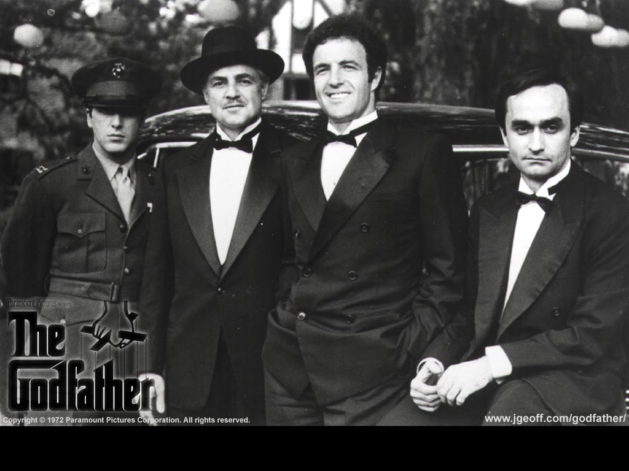
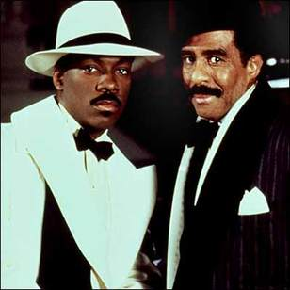


History and Politics of Race

Slide 15


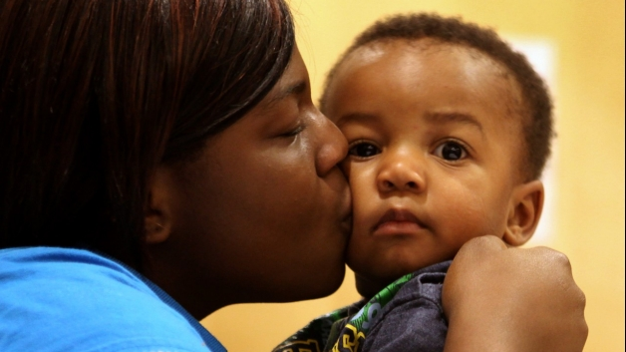

Family Values/Relationships

Slide 16
Parenting African Nova Scotian Children
Robert S. Wright, MSW, RSW

