Slide 1
Generational Diversity in the Workplace: Engaging and Retaining Millenials
Cumberland Employment & Career Fair
January 19th, 2012
Robert S. Wright, MSW, RSW
www.robertswright.ca

Slide 2
Working with Diversity
Working together is easier the more similar we are.
Working together is easier if our methods of working fit our life experience and values
Many implications flow from these proposition
Sue, D. W. & Sue, D. (1990). Counselling the Culturally Different: Theory and Practice. Oxford: Wiley.

Slide 3
Working With Diversity
We must understand our cultural differences and similarities
We must understand the social and cultural reality we work in
We must be able to generate a wide variety of verbal and non-verbal responses

Slide 4
Understanding Cultural Difference (Nichols’ Model)
Different world cultures developed out of differing physical environments. These world views have differing constructs:
Axiology (values)
Epistemology (way of knowing)
Logic (principles of reason)
Process (practice of reason)

Slide 5
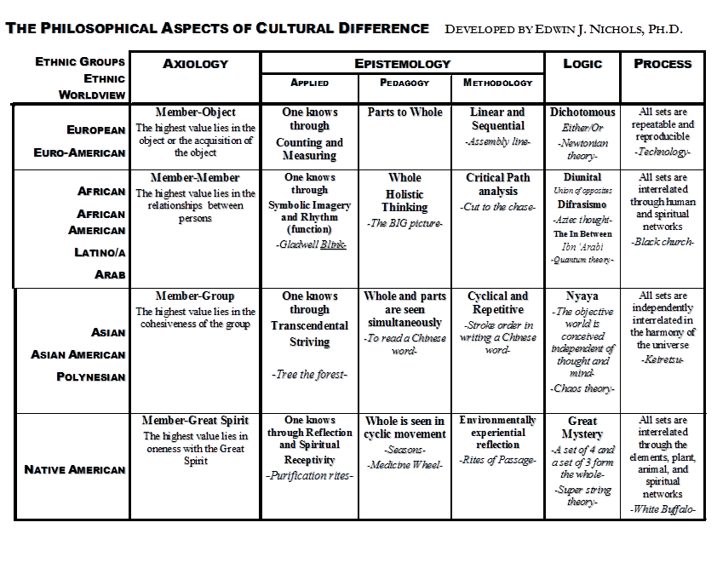

Slide 6
The “Generations”
Traditionalists (born before 1946)
Baby Boomers (born 1946 – 1960)
Generation X (born 1960 – 1979)
Millennials (born 1979 – 1994)

Slide 7
Generational Differences
When we understand that the cultures of the different generations is formed by their environment and experiences, then the differences begin to make sense.
Consider the differences between Traditionalists and Generation X

Slide 8
Comparing Thelma and Robert
Thelma | Robert
Born 1932 | Born 1967
Education – 1 year post High School | Education – MSW
Career – 37yrs, in 1st, 22yrs in 2nd job | Career – 23yrs, 10 jobs
Promoted – lowest job to Chief of Division | All advances came from changing jobs
Married – 60yrs | Married 12yrs, Divorced, Single ~ 12yrs
Owns Home | Rents
Whole working life in 1 city | Lived and worked in 5 cities in 2 countries and 3 states/provinces
Church centre of social and civic life | Multiple agencies, civic groups and associations

Slide 9
The Millenials
Said to be/need:
Constant affirmations
Continual communication from company exec.’s
Resistant to criticism on the job
Disrespectful or non-respecting of authority
Lacking work ethic and commitment to work

Slide 10
Experience of “Millenials”
Have never seen an eager young person jog to their car to pump gas
Have never seen a youth with a paper route
Have seen rural opportunities for labour either disappear or lose their value
Have never been told if you work hard you can be the head of this company someday
Are never offered work benefits that are relevant to their lifestyle

Slide 11
Experience of “Millenials”
Are rejected and excluded from power and economic structures
Are chronically over educated and underemployed
Are aware and connected to international experiences of disenfranchisement – fair trade
Express this rejection in the Arab Spring and the Occupy Movement

Slide 12
The “Millenials”
Are “Robot Chicken”, “Rick and Steve” and “The Boondocks” not “Friends”, “Will and Grace”, or “the Cosby Show”
They are “Occupy” not young Liberals, Conservatives or NDP (they’re not even The Greens!)
They are not “Boys in the Basement” they are communally living, transients
They are “Backpack” not “Hope Chest”

Slide 13
So How Do We Engage “Millenials”
Employers with post-modern products, values, environments, benefits and organizational structures will engage “Millenials”
Products that are free trade, environmentally progressive, local and contributing to global justice
Values that are open, accepting, critically deep, caring globally about more than profits
Environments that are flexible, adaptive, accommodating, non-conformist
Benefits that are immediate, health promoting, communally generous
Organizations that are transparent, flat, responsive

Slide 14
The Impossible is Inevitable
So, you say . . . This is impossible. We are a factory, packing plant, construction company, traffic control, hotel chain . . . Our business models can’t operate like that!
Millenials reject your arguments:
They have seen capitalism suspend the rules to bail out bankers
They have seen nations wage trillion dollar wars during “hard times”
They know everything can change if people want it to change – and they are right!
Besides if you don’t learn to engage them, you will be out of business in less than a decade

Slide 15
It Starts Here
Advice:
I should be the last non-Millenial consultant you hear from on this issue
Don’t start your business’ conversation in the board room
Charge the “Millenials” you currently employ in substantial conversations to shape your future
Start with the question “What would make your friends want to work here?”

Slide 16
Final Message
“Millenials” and the generations that follow them ARE the present and future, embrace them
They are egalitarian, internationalists, who seek a better world – A positive creative force
By rejecting everything they are well positioned to see the solutions that elude us
They are the foundation of the new global economy, if you reject them you’re already lost

Slide 17
Generational Diversity in the Workplace: Engaging and Retaining Millenials
Cumberland Employment & Career Fair
January 19th, 2012
Robert S. Wright, MSW, RSW
www.robertswright.ca

